Slide 1
Introduction to statistics, experimental design and hypothesis testing
Session I
Michela Traglia and Reuben Thomas
Bioinformatics Core, GIDB
Gladstone Institutes
September 10th and 12th, 2024

Slide 2
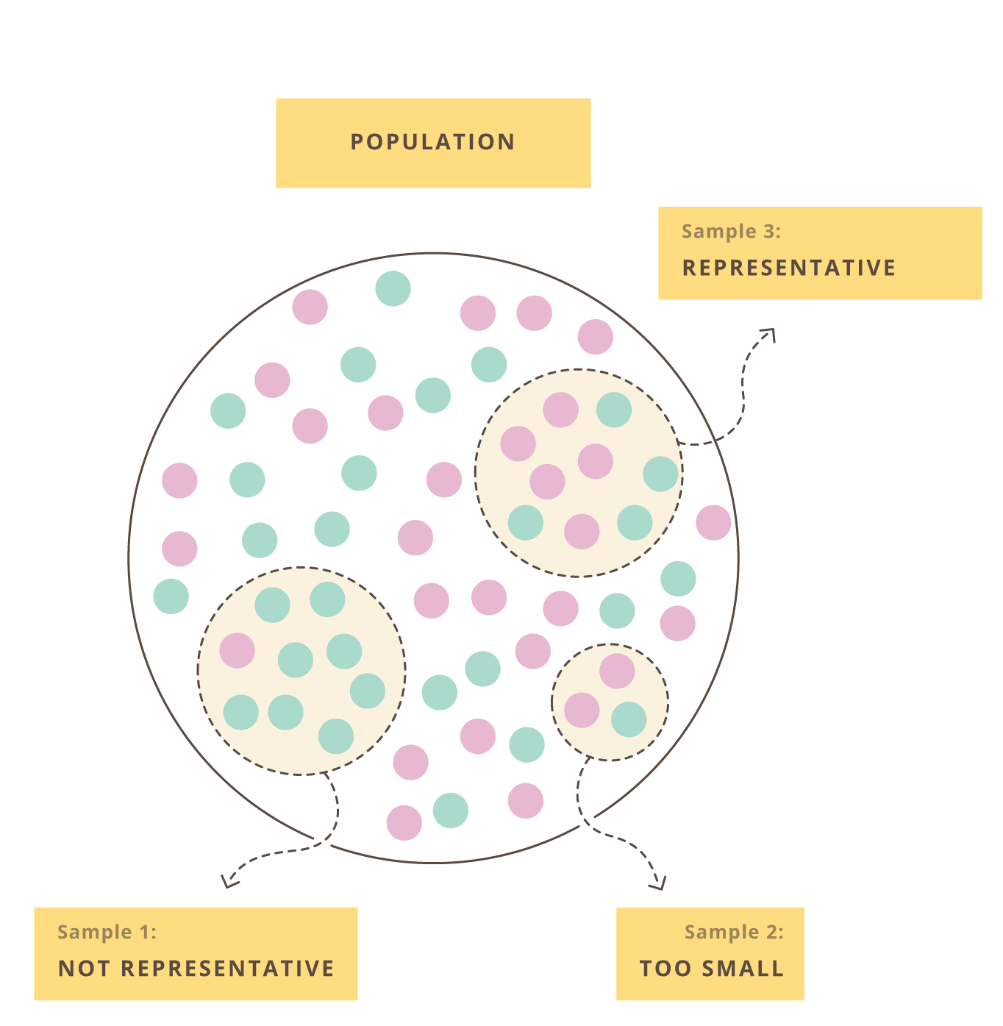
Data collection is fundamental to make general claims
Empirical data are noisy
Resources are limited
Generalize our scientific claims as much as possible
Experimental design refers to…
The organization of an experiment, to ensure that the right type of data, and enough of it, is available to answer the questions of interest as clearly and efficiently as possible.

Slide 3
Outline of the workshop
Today
Experimental design principles I
Thursday
Experimental design principles II
Assign treatment to groups
Batch effects

Slide 4
Experimental design principles I
Define the research questions
What system
Hypotheses
Define the variables
Collect the samples
Define the confounding variables

Slide 5
1. Define the research question
A specific issue, contradiction between two or more perspectives, or a gap in knowledge that you will aim to address in your research

Slide 6
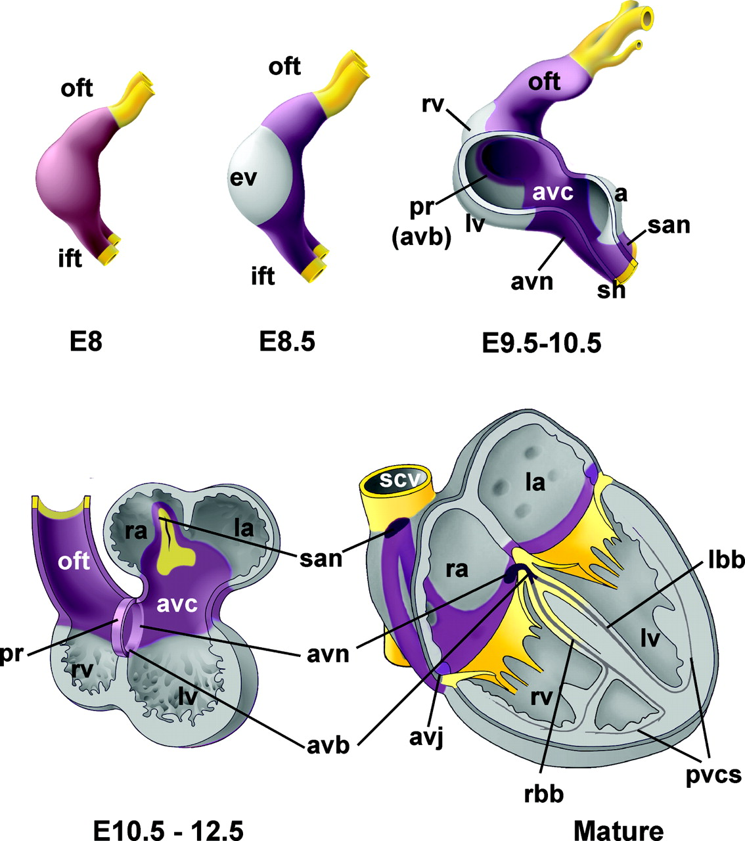
Research question 1
Gene controlling developing heart
https://www.ahajournals.org/doi/epub/10.1161/CIRCEP.108.829341

Slide 7
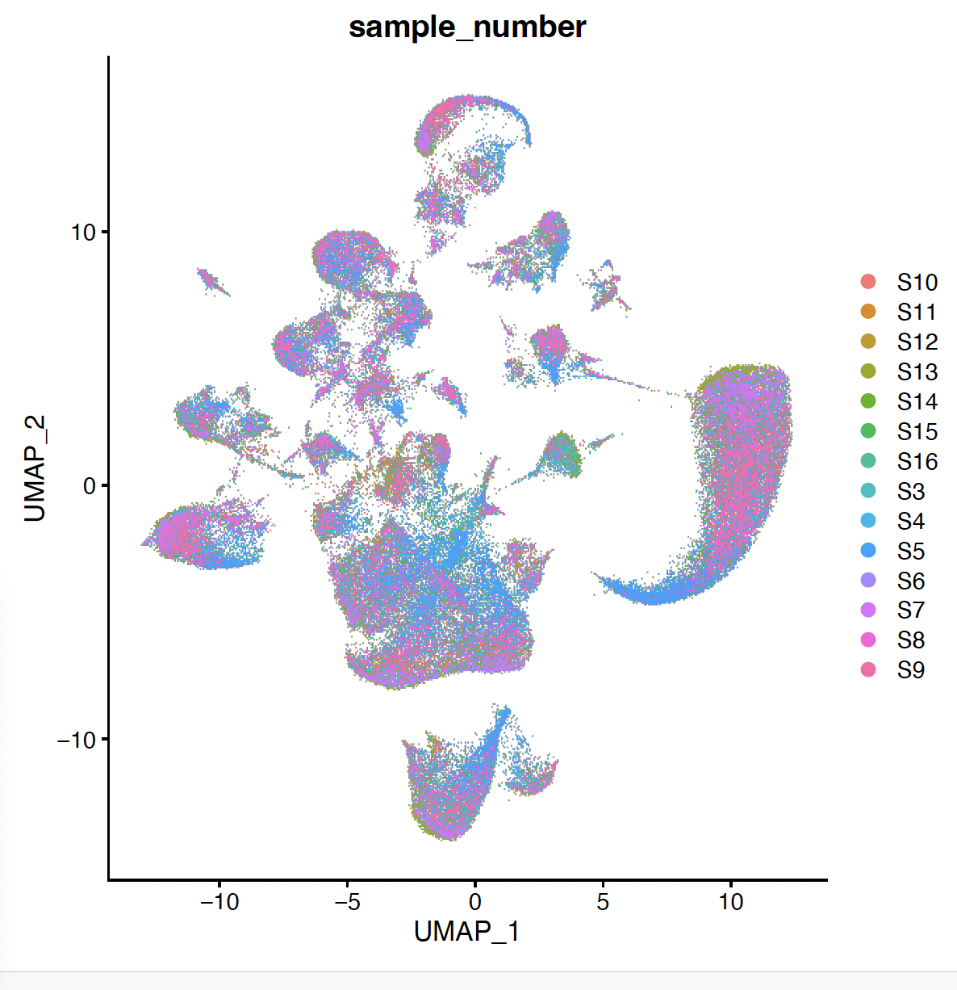
Difference in gene expression by genotype in mice at cell type level
WT - mutant gene
WT vs KO gene
Research question 2

Slide 8
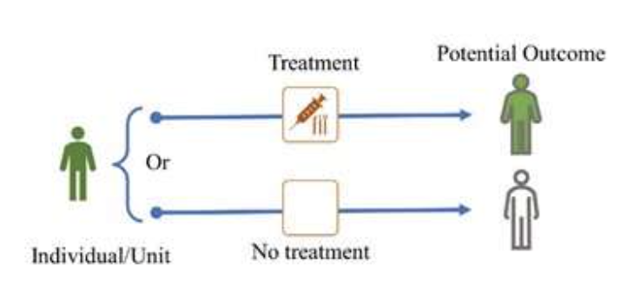
Effect of a treatment on outcome
Research question 3

Slide 9
2. Understand the system you are going to study
Observational studies
Experimental studies
Researchers don’t assign exposure
Observing what is already happening
No establishing cause-effect
Ex. Case-controls, cohort
Descriptive
Researchers manipulate factors
Create a treatment and compare the response
Changes cause an effect
Ex.Clinical trials
Causal

Slide 10
3. Formulate your hypothesis
Animal model of AD show gene expression alteration compared to WT
‘AD knock-in gene’ animal models show overexpression/underexpression (alteration) of genes in some brain cell types implicated in AD vs WT
and then write a null and alternative hypothesis
H₀: AD knock-in mice have identical gene expression in relevant brain cell types compared to WT
H₁: AD knock-in mice have alteration of gene expression in relevant brain cell types compared to WT.

Slide 11
4. Define the variables of interest
Risk factors
Genotype (MUT or WT)
Disease
Gene expression
In an experiment, the researcher manipulates an independent variable to study its effects on a dependent variable (response)

Slide 12
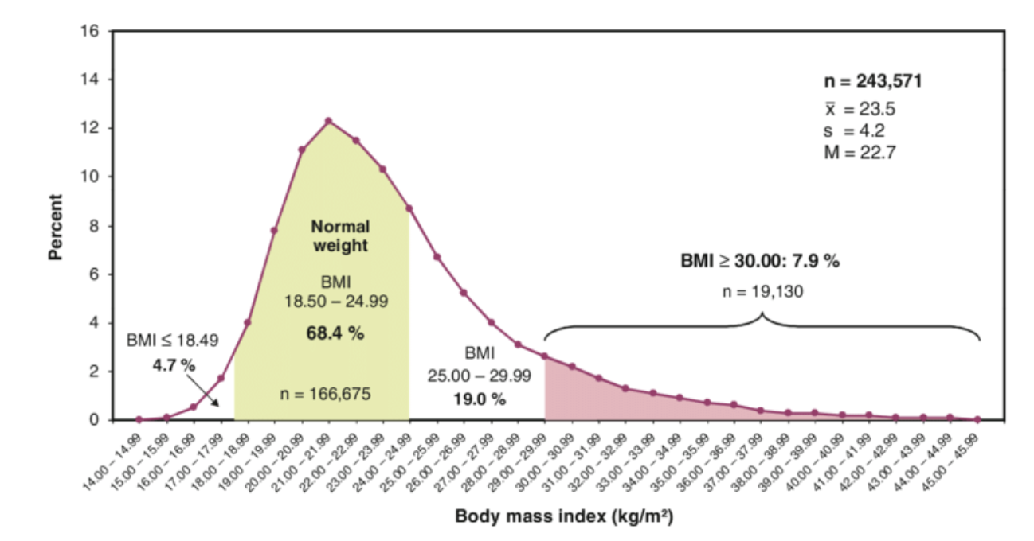

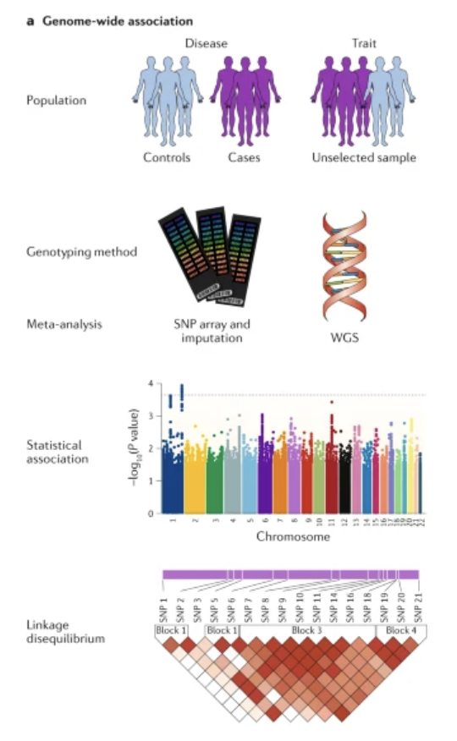

What is the effect of the risk genetic factors on BMI levels in a human cohort
DOI:10.1007/s00404-009-1349-9
How many indivs do I need to make claims about my question?

Slide 13
Experimental design guides data collection
Maximum amount of relevant data for the research at minimum resource spend
Minimize the number of experiments
Source of variations evaluation, variables/factors that could affect the system.
The goal is to collect enough data to statistically test whether you can reasonably reject the null hypothesis in favor of the alternative hypothesis

Slide 14
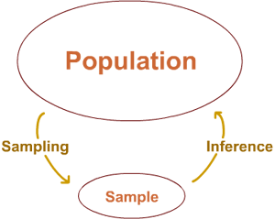
5. From the population to a sample
All subjects/units that we want base our claims/conclusions on
The cardiac tissue of all mice at embryonic stage E9.5
Male BMI
AD mice
Target population - generalization
Data is expensive
Studying of the sample -> Conclusion on the population
Experimental units are the smallest entities that can be independently assigned to a treatment (e.g., animal, litter, cage, well).

Slide 15
Sample size - larger always better?
As always, it depends…
on what we want to do (differential gene expression, variant detection, GWAS, …)
on the variability between samples (cell lines, inbred animals, patients, …)
on the magnitude of the expected effect
Tips
Set a sample size in advance and estimate the power of the experiment to detect differences of various sizes
Pilot experiments to guide sample size estimation

Slide 16
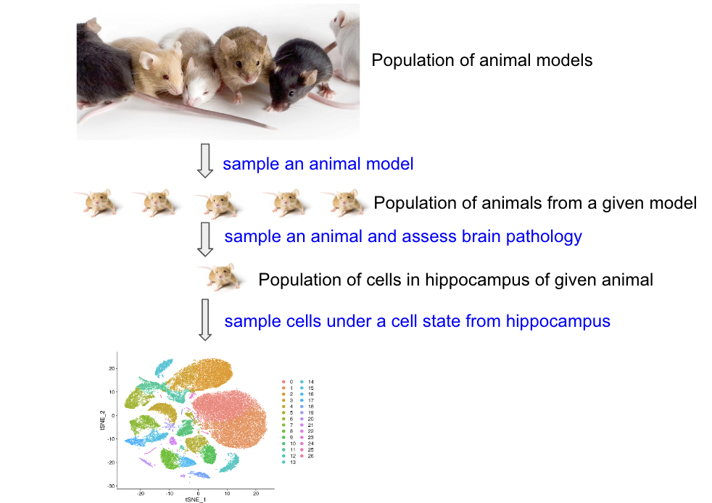
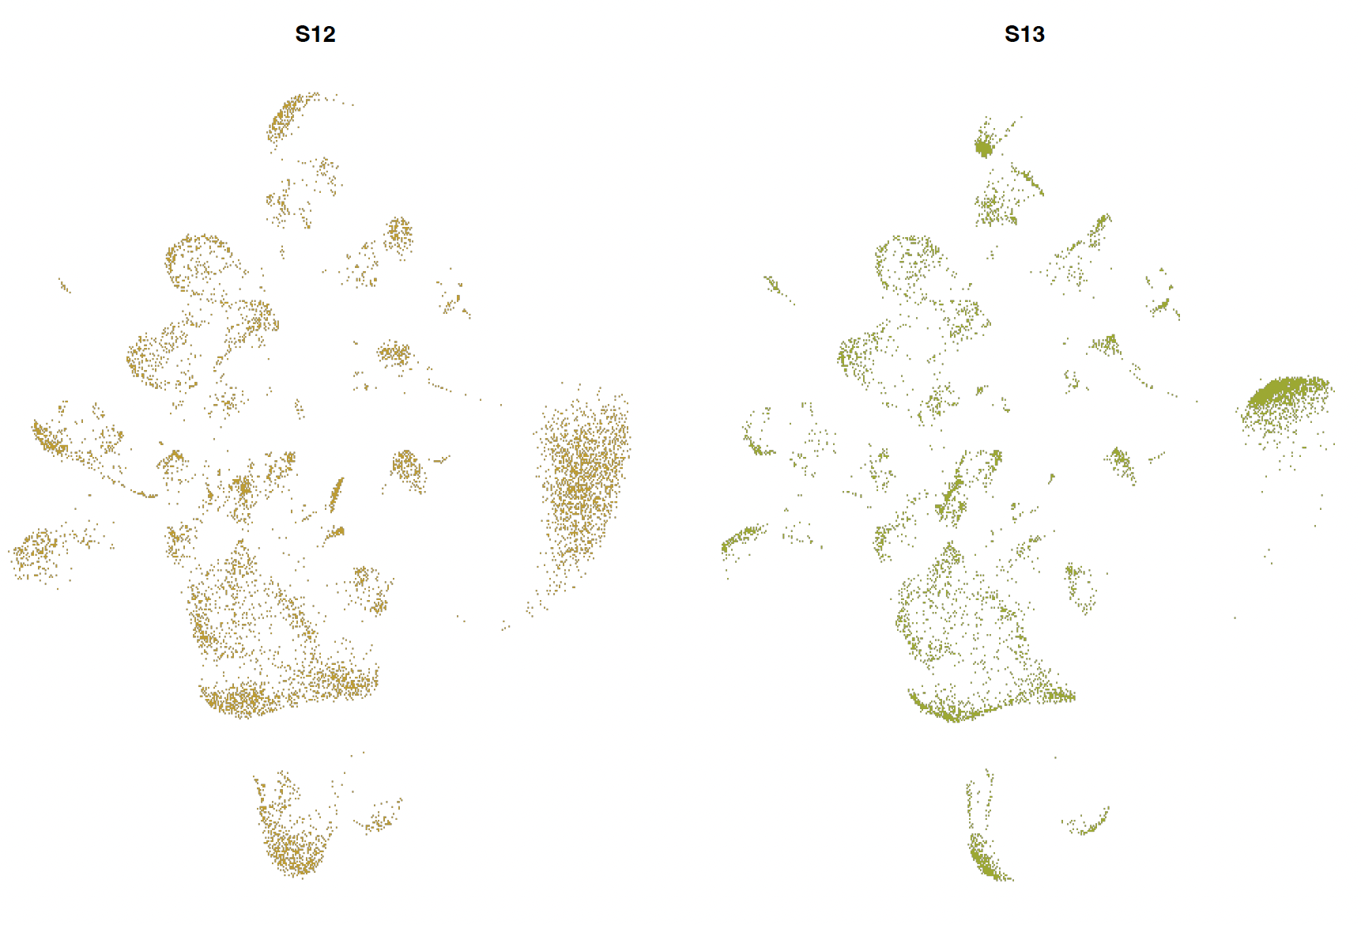
Replicates
scRNA-seq experiment – gene expression differences between WT and mutated mice
Sampling
Population of animal from a given genotype
Within same genotype,
two distinct animals -> biological variability

Slide 17
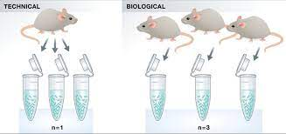
Biological vs technical replicates
Biological replicates are biologically distinct samples (for ex. same condition) showing biological variation.
# of replicates that give a high probability of detecting an effect of practical importance.
At minimum you should have three biological replicates for treatment.
Technical replicates are same sample repeated measurements (reproducibility?)
Technical replication is essential when part of the experimental objective is to measure the measurement error.
Notes:
Learn more about replicates and repeats:https://support.minitab.com/en-us/minitab/18/help-and-how-to/modeling-statistics/doe/supporting-topics/basics/replicates-and-repeats-in-designed-experiments/

Slide 18
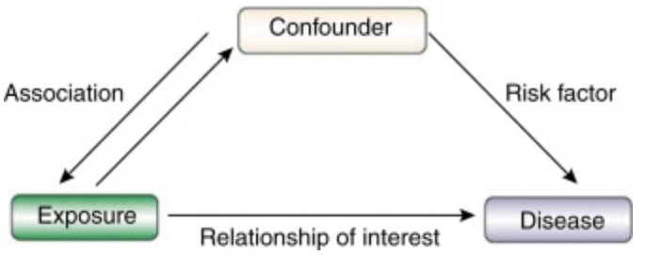
6. Confounding variables
Independent variable
Outcome, dependent variable
Biological factors that could affect the response (e.g. disease)
-smoking, ethnicity, gender
Non-biological or technical factors that could affect the response.
-time/day/month of experiment/batch
-reagents used, reagents batch used
-technician
A variable that is not included in an experiment, yet affects the relationship between the two variables in an experiment - unremoved unwanted variation
Design the experiment to eliminate (as much as possible) the risk of confounding variables!!

Slide 19
Knowing how to deal with the challenges of experimental design is central to achieving reproducible experiments.
Identify the response and variables of interest
Identify target population that you want to base your claims on
Identify factors that affect the response of interest
Choose samples from target population
When well-designed, experiments minimize any bias to make stronger inferences about the differences we see in the experiment.

Slide 20
Please take the survey:
https://www.surveymonkey.com/r/F75J6VZ

Slide 21
Introduction to statistics, experimental design and hypothesis testing
Session II
Michela Traglia and Reuben Thomas
Bioinformatics Core, GIDB
Gladstone Institutes
September 12th, 2024

Slide 22
Outline of the workshop
Tuesday
Experimental design principles I
Today
Experimental design principles II
Assign treatment to groups
Batch effects

Slide 23
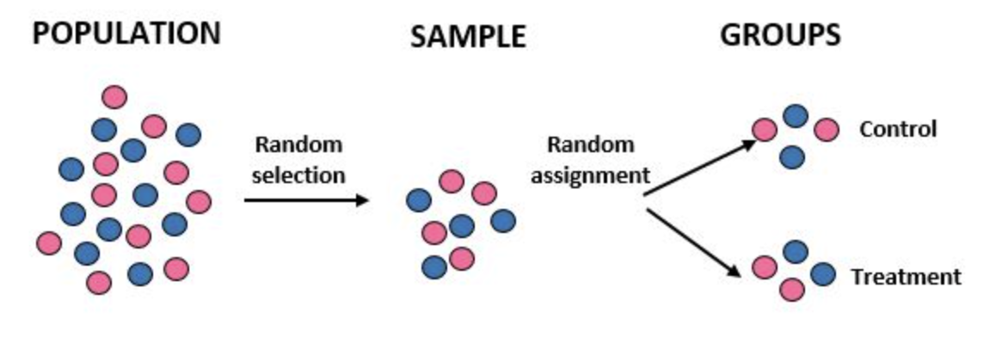
7. Assign treatment to groups
Experiment: compare control and treated groups

Slide 24
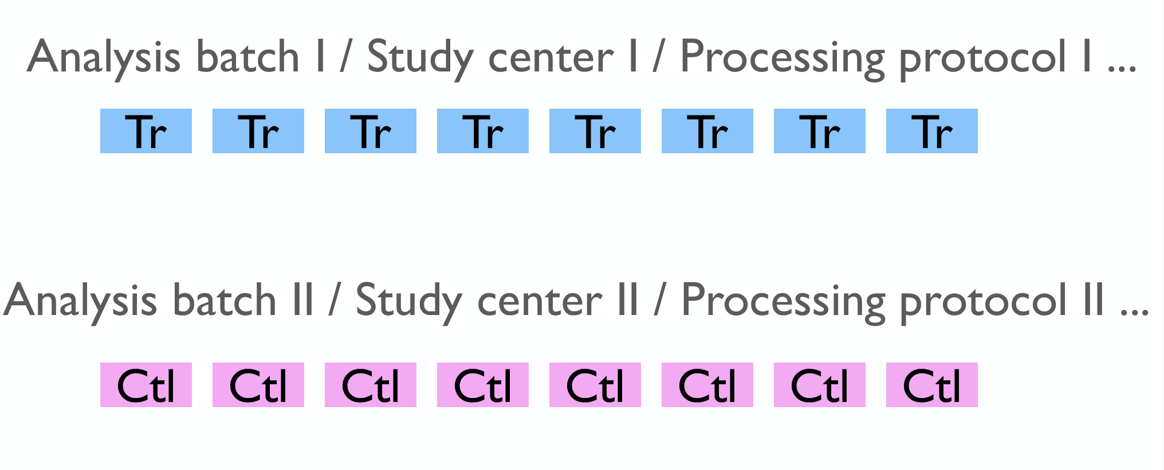
Scenario I
Bad assignment!

Slide 25
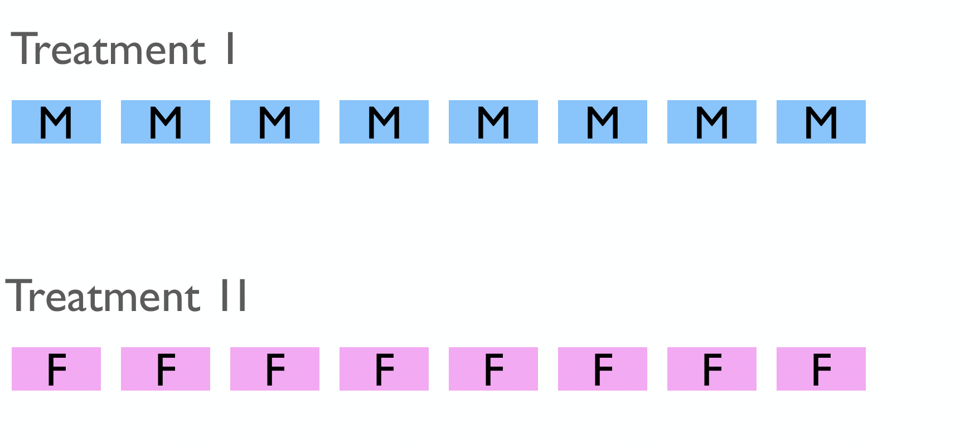
Scenario II
Bad assignment!

Slide 26
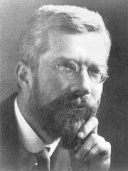
Ronald Fisher
"Analysed data from Classical Field Experiments"
Overcome the large amount of variation in agricultural and biological experiments that often confused the results
This motivated him to find experimental techniques that could
eliminate as much of the natural variation as possible
prevent unremoved variation from confusing or biasing the effects being tested
detect cause and effect with the minimal amount of experimental effort necessary - time consuming and costly
Statistical Methods for Research Workers in 1925 and The Design of Experiments in 1935
Notes:
https://www.historyofdatascience.com/ronald-aylmer-fisher/

Slide 27
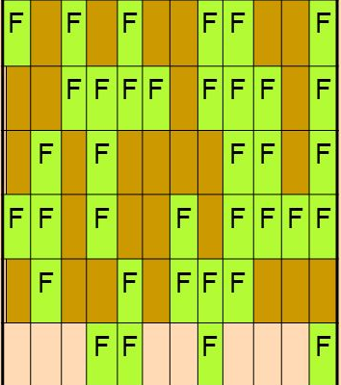
Randomization
Fisher -> helps to avoid biases due to changes in background or confounding variables.
One of the main purposes for experimental designs is to minimize the effect of experimental error.
Randomization, replication, and blocking, are methods of error control.
Well-designed experiments are characterized by three features: randomization, replication, and local control.

Slide 28
Randomization
Randomly assign subjects to treatment and control groups in order to minimize bias and moderate experimental error.
Assign random numbers so that any experimental unit (EU) has equal chances of being assigned to treatment or control
Can create unequal numbers between treatment and control groups.
Appropriate only for experiments with homogeneous experimental units (e.g., mice should be of same sex, strain, age, etc.) where environmental effects, such as light or temperature, are relatively easy to control.

Slide 29
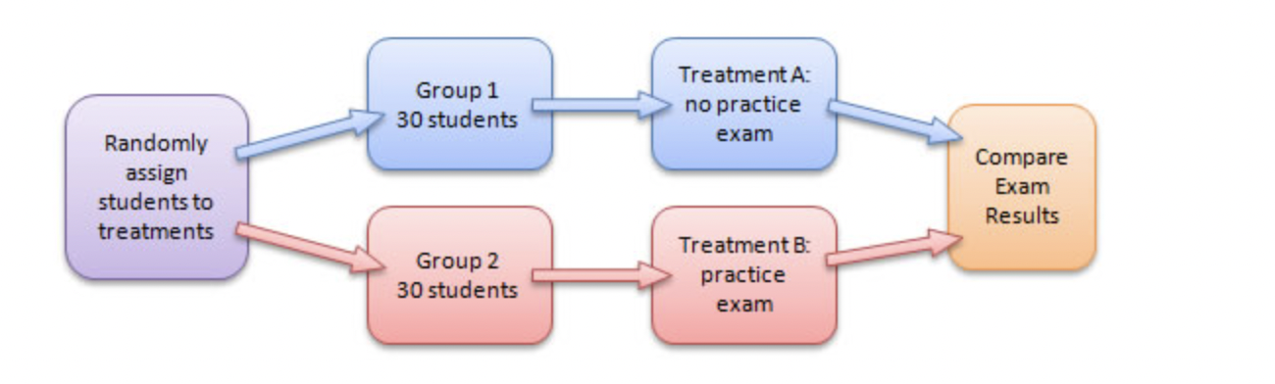
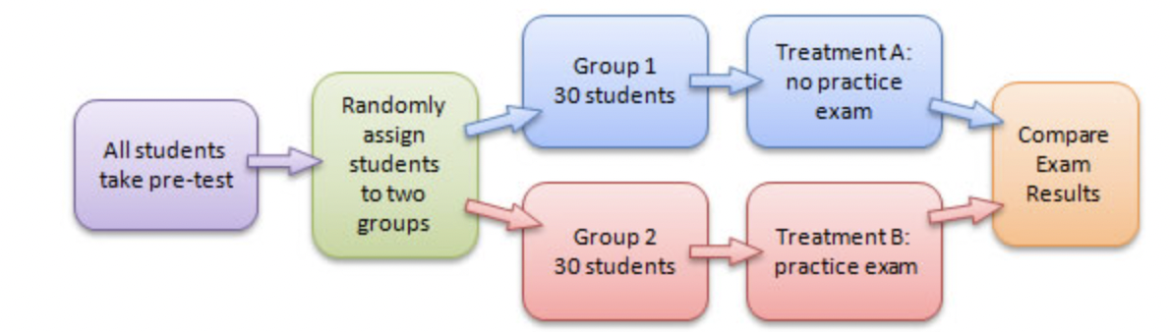
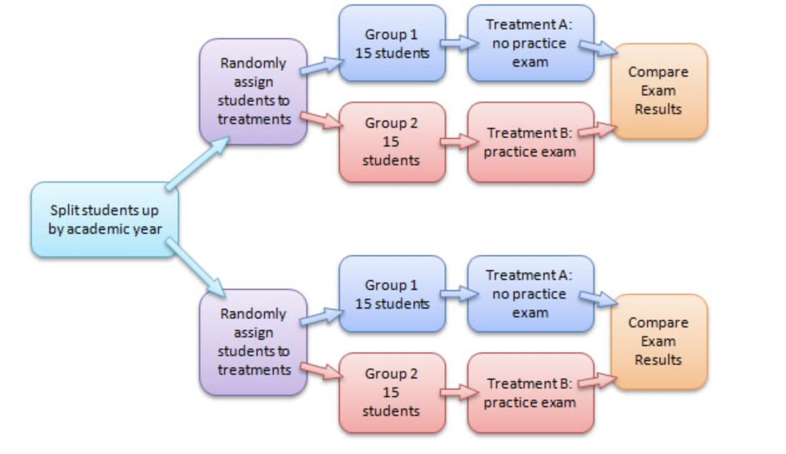
Randomization and blocking
Completely Randomized Design
Matched-Pairs Design
Randomized Block Design
Notes:
https://faculty.elgin.edu/dkernler/statistics/ch01/1-6.html

Slide 30
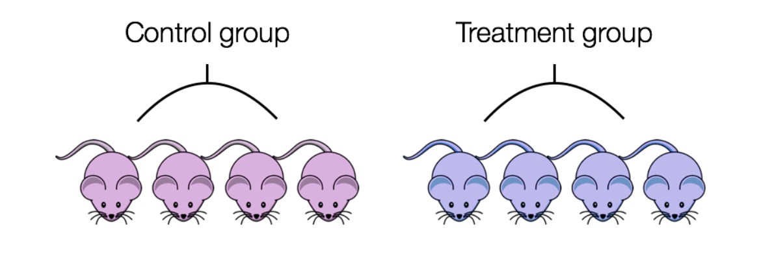
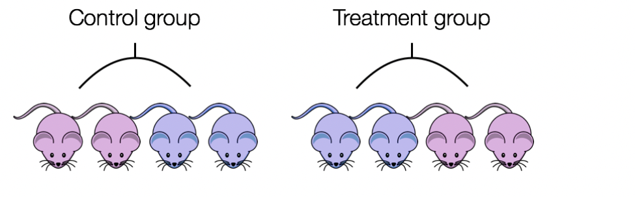
Blocking
If all control mice were female and all of the treatment mice were male, then the treatment effect would be confounded by sex.
Ensure animals in each condition are all the same age, sex, litter and batch, if possible.
If not, split animals equally between conditions.
Blocking approach helps to reduce variability unexplained in the model

Slide 31
Capture effects of interest and avoid unwanted variation in experiment
Identify the response and variables of interest
Identify target population that you want to base your claims on
Identify factors that affect the response of interest
Choose samples from target population
Randomly assign samples across different levels of factors affecting response
Block out variation that is not of interest by randomly assigning to levels of factors within a block
“Block what you can control; randomize what you cannot control”

Slide 32
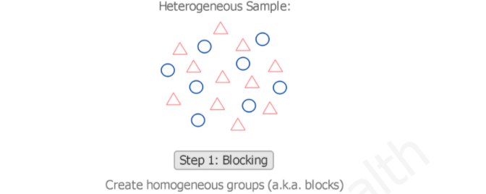
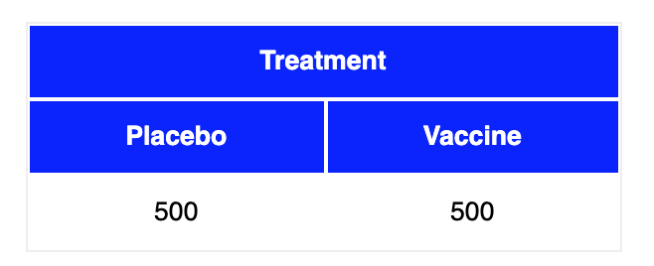
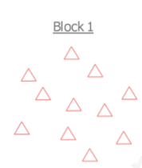
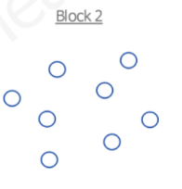
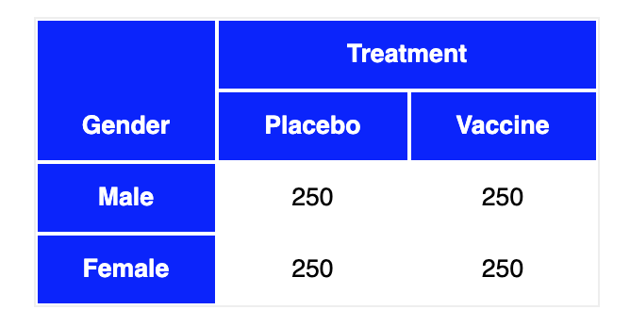
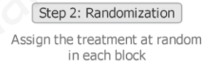

Randomized block design
https://quantifyinghealth.com/randomized-block-design/
https://stattrek.com/experiments/experimental-design.aspx

Slide 33
Which one is the best design?
 | Design 1 – Sample prep date | Design 2 – Sample prep date
Sample_1_E9.5 | Jan 9th, 2019 | Jan 11th, 2019
Sample_2_E9.5 | Jan 9th, 2019 | Jan 9th, 2019
Sample_3_E9.5 | Jan 9th, 2019 | Jan 11th, 2019
Sample_4_E9.5 | Jan 9th, 2019 | Jan 9th, 2019
Sample_1_E11.5 | Jan 11th, 2019 | Jan 11th, 2019
Sample_2_E11.5 | Jan 11th, 2019 | Jan 9th, 2019
Sample_3_E11.5 | Jan 11th, 2019 | Jan 11th, 2019
Sample_4_E11.5 | Jan 11th, 2019 | Jan 9th, 2019
Design 3 – Gender | Design 4 - Gender
Male | Male
Male | Female
Male | Male
Male | Female
Female | Male
Female | Female
Female | Male
Female | Female

Slide 34
Between-subjects vs within subjects design
In a between-subjects design (or between-groups design)
- every experimental unit experiences only one condition,
- group differences between participants in various conditions
Also called independent measures or independent-groups design because compare unrelated measurements taken from separate groups.

Slide 35
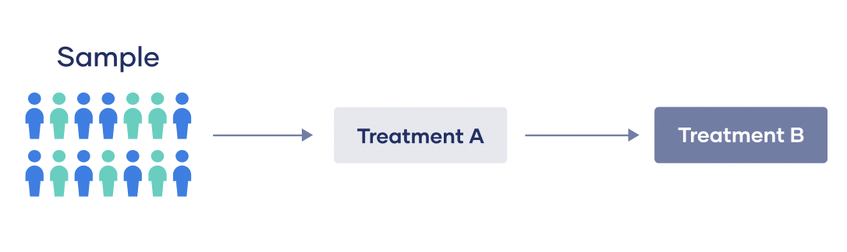
Between-subjects vs within subjects design
In a within-subjects design (or repeated measurement design)
- every experimental unit experiences all the conditions,
test the same individuals repeatedly to assess differences between conditions
Also called a dependent groups or repeated measures design because compare related measures from the same individuals between different conditions.
Linear Mixed Effects Model workshop - Oct 2024

Slide 36
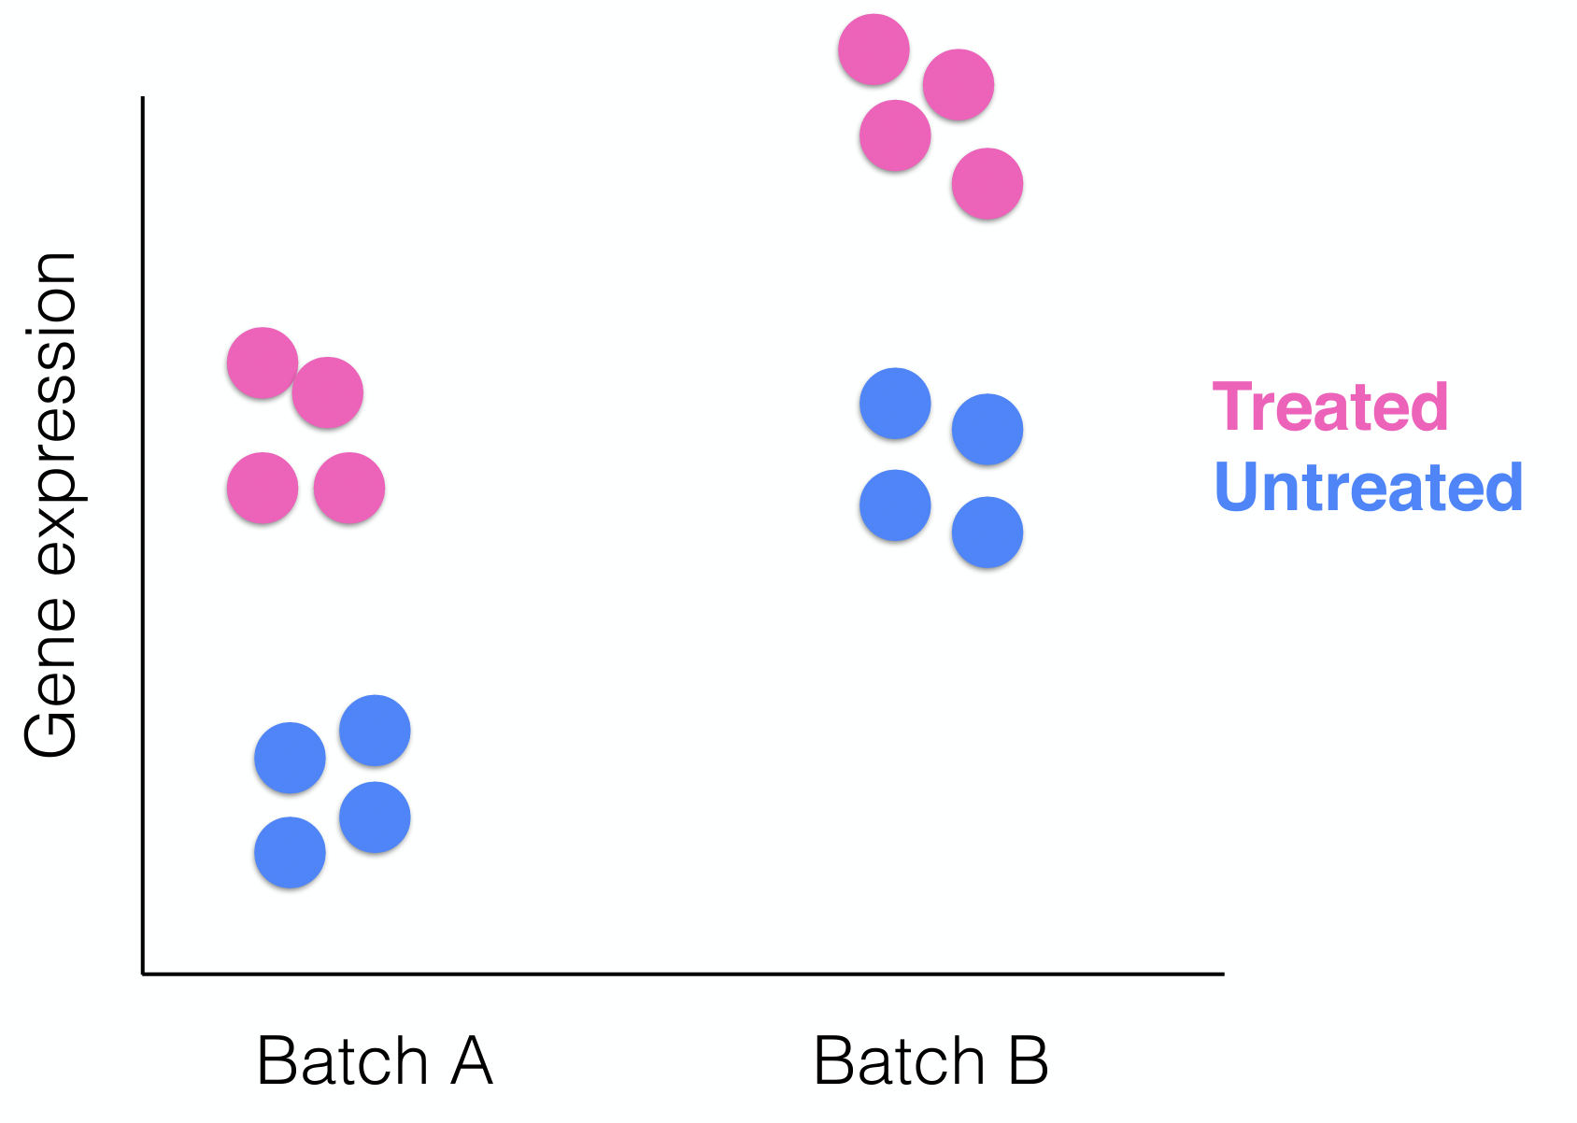
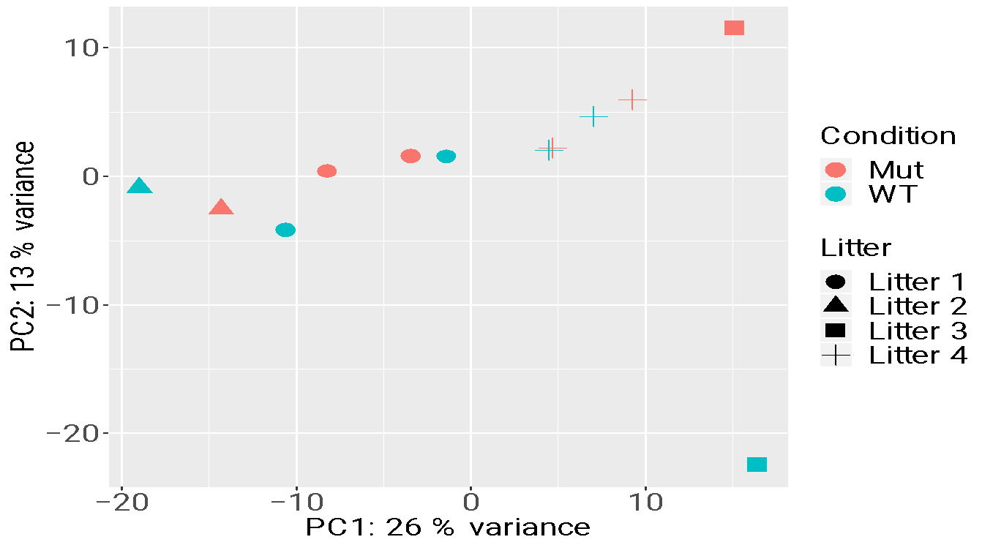
8. Is the variation between groups driven by the biology?

Slide 37
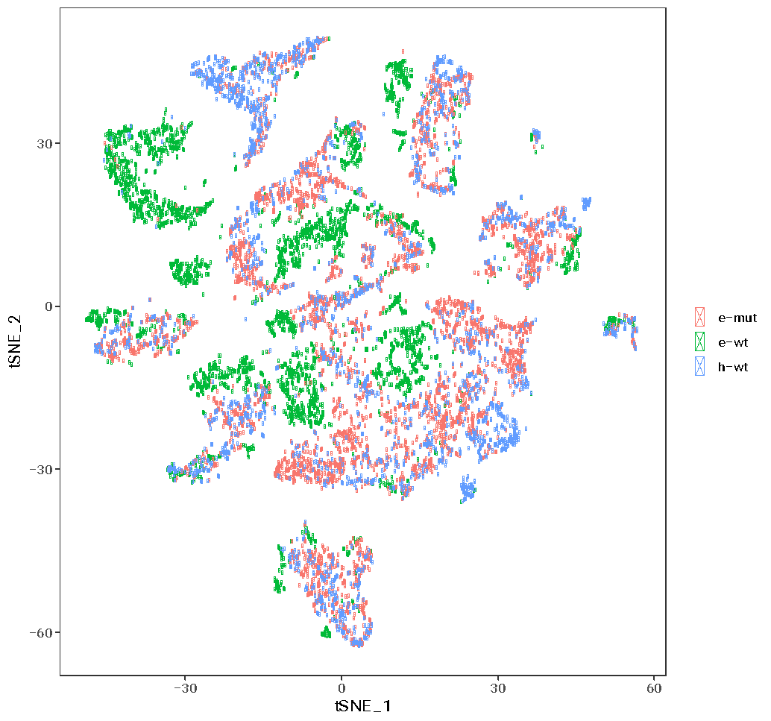
Confounding in scRNA-seq data is a problem
Notes:
Hicks, S. C., Townes, F. W., Teng, M. & Irizarry, R. A. Missing data and technical variability in single-cell
RNA-sequencing experiments. Preprint available from:https://doi.org/10.1093/biostatistics/kxx053 (2017).

Slide 38
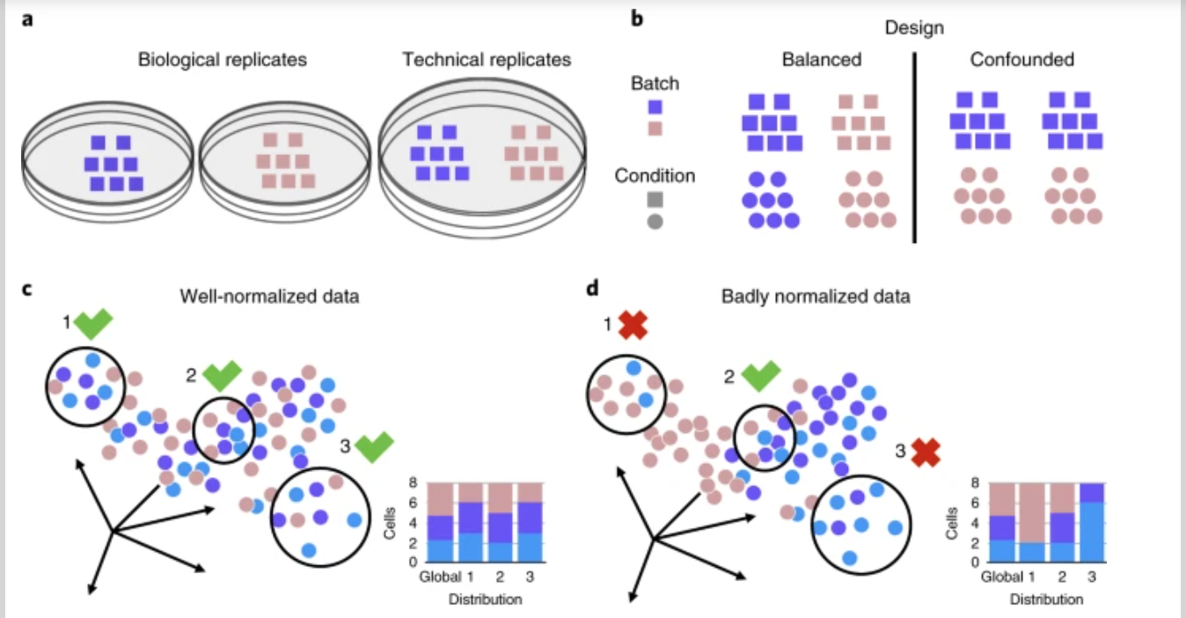
Well and badly analyzed scRNA-seq data
https://www.nature.com/articles/s41592-018-0254-1

Slide 39
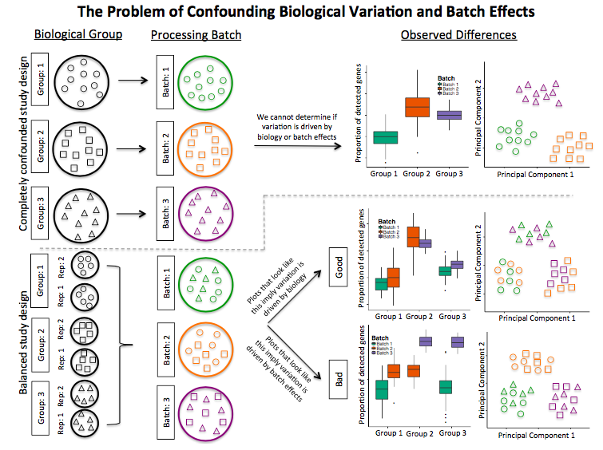
Confounding biological variation and batch effects

Slide 40
Hot to know whether you have batches
Were all RNA isolations performed on the same day?
Were all library preparations performed on the same day?
Did the same person perform the RNA isolation/library preparation for all samples?
Did you use the same reagents for all samples?
Did you perform the RNA isolation/library preparation in the same location?
If any of the answers is ‘No’, then you have batches.

Slide 41
Isolate batch effects for RNA-seq
If unable to avoid batches:
Split replicates of the different sample groups across batches.
The more replicates the better (definitely more than 2).
Include batch information in your experimental metadata.
During the analysis regress out the variation due to batch if not confounded so it doesn’t affect the results.
scRNA-seq workshop – Sept 16-17, 2024

Slide 42
Take – home messages
Plan ahead
Prevent bias from uncontrollable
Randomization and balancing
Write it down in an Experimental plan
Follow the experimental plan
Be careful with interpretation of results!
Notes:
Suggested reading: Stephen M.. 2016. Seven Pillars of Statistical Wisdom. Harvard University Press

Slide 43
Real data is complex
This workshop provides an introduction to typical experimental design and statistics.
Experimental design can be very complicated
Real data might need additional analyses choices.
Some analysis choices need experience.
Consult with the Gladstone Bioinformatics core for such scenarios and data.

Slide 44
For questions:
michela.traglia@gladstone.ucsf.edu
reuben.thomas@gladstone.ucsf.edu
Slack: #questions-about-bioinformatics
Thank you!
Please take the survey:
https://www.surveymonkey.com/r/F75J6VZ

